Slide 1


Edit 1

Slide 2

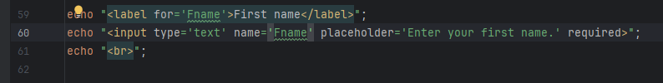
Edit 2

Slide 3
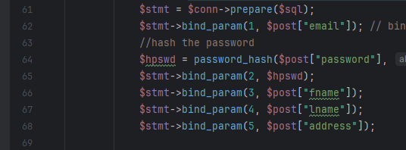
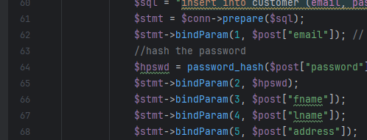
Edit 3

Slide 4


Edit 4

Slide 5

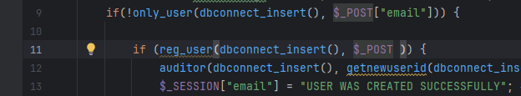
Edit 5

Slide 6
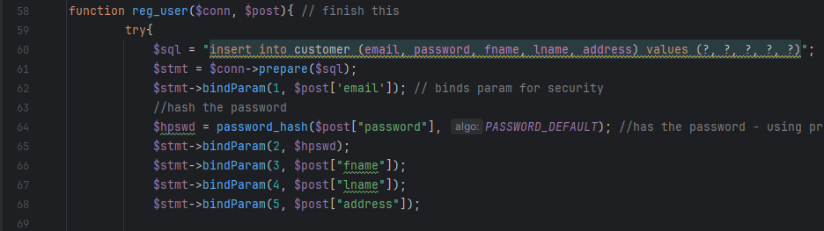
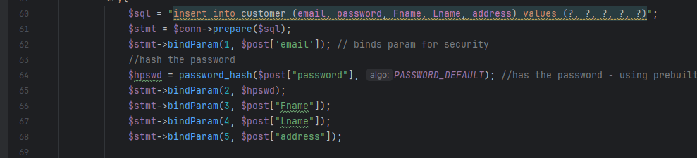
Edit 6

Slide 7
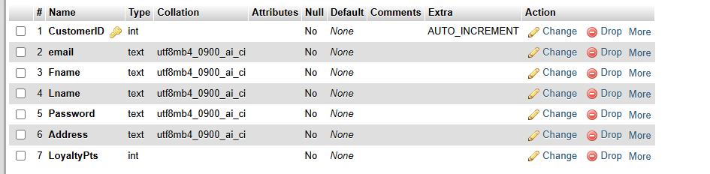
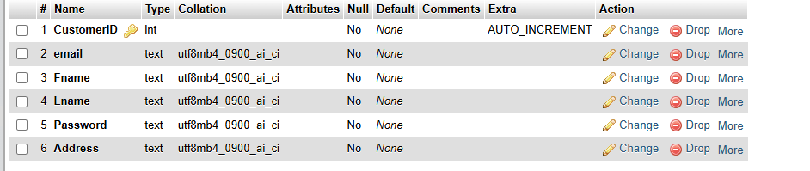
Edit 7

Slide 8


Edit 8

Slide 9
Edit 9

Slide 10
Edit 10
((And replaced every other instance of User_id to CustomerID)

Slide 11
Edit 11

Slide 12
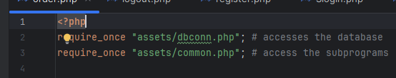
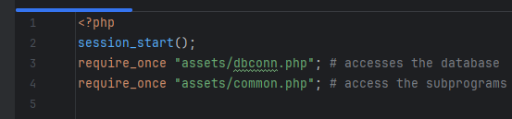
Edit 12

Slide 13
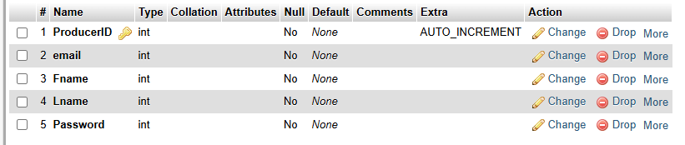
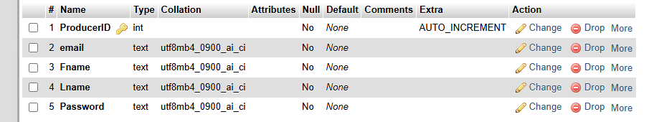
Edit 13

Slide 14
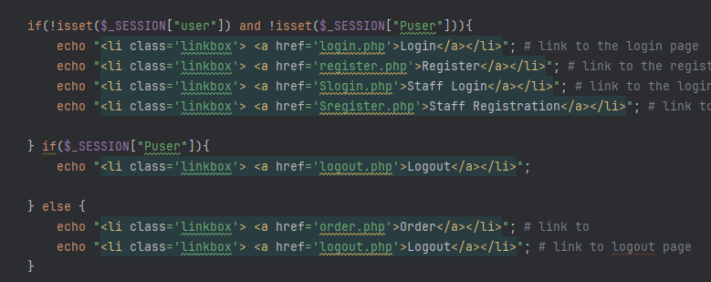
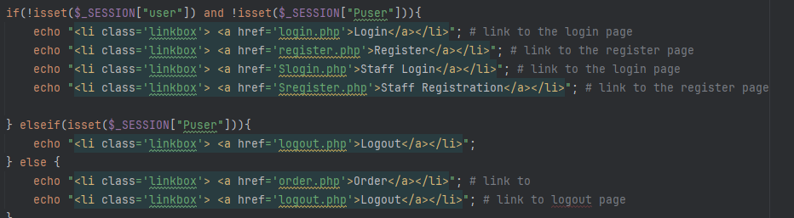
Edit 14

Slide 15
Edit 15

Slide 16


Edit 16

Slide 17

Edit 17

Slide 18


Edit 18

Slide 19


Edit 19

Slide 20
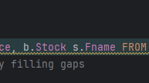

Edit 20

Slide 21
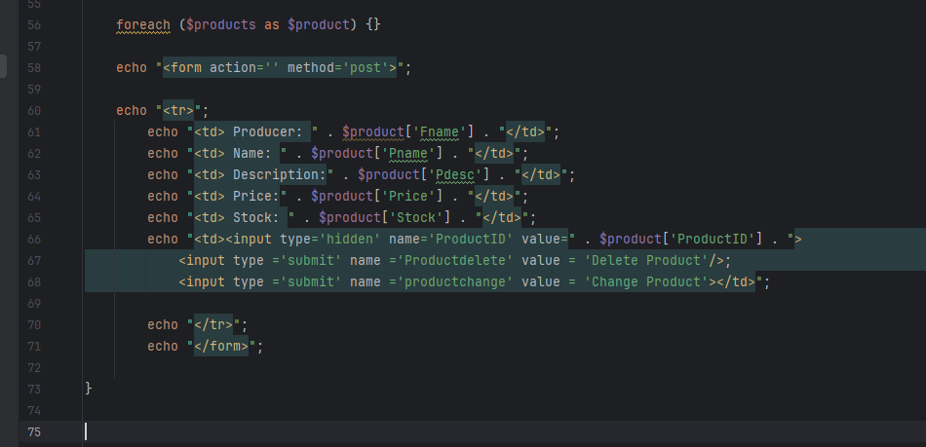
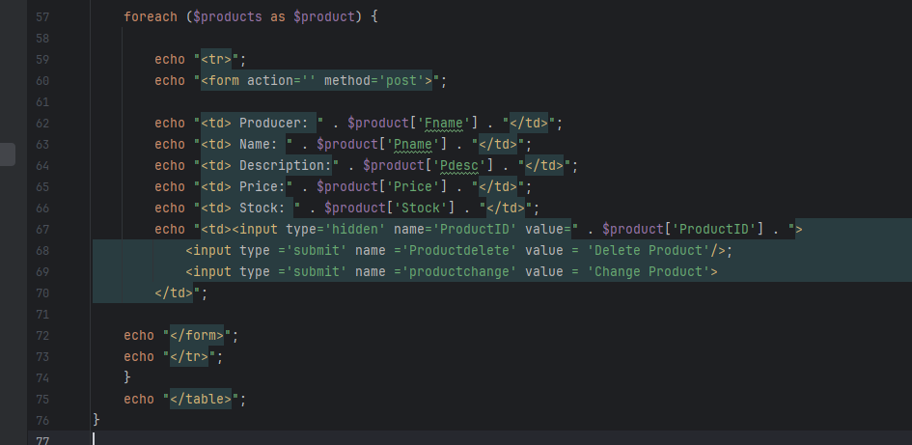
Edit 21

Slide 22

Edit 22

Slide 23
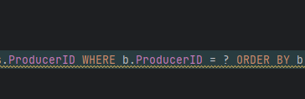

Edit 23
Removed where statement

Slide 24


Edit 24

Slide 25
Edit 25

